Slide 1
Cheatsheet for interprobe

Slide 2
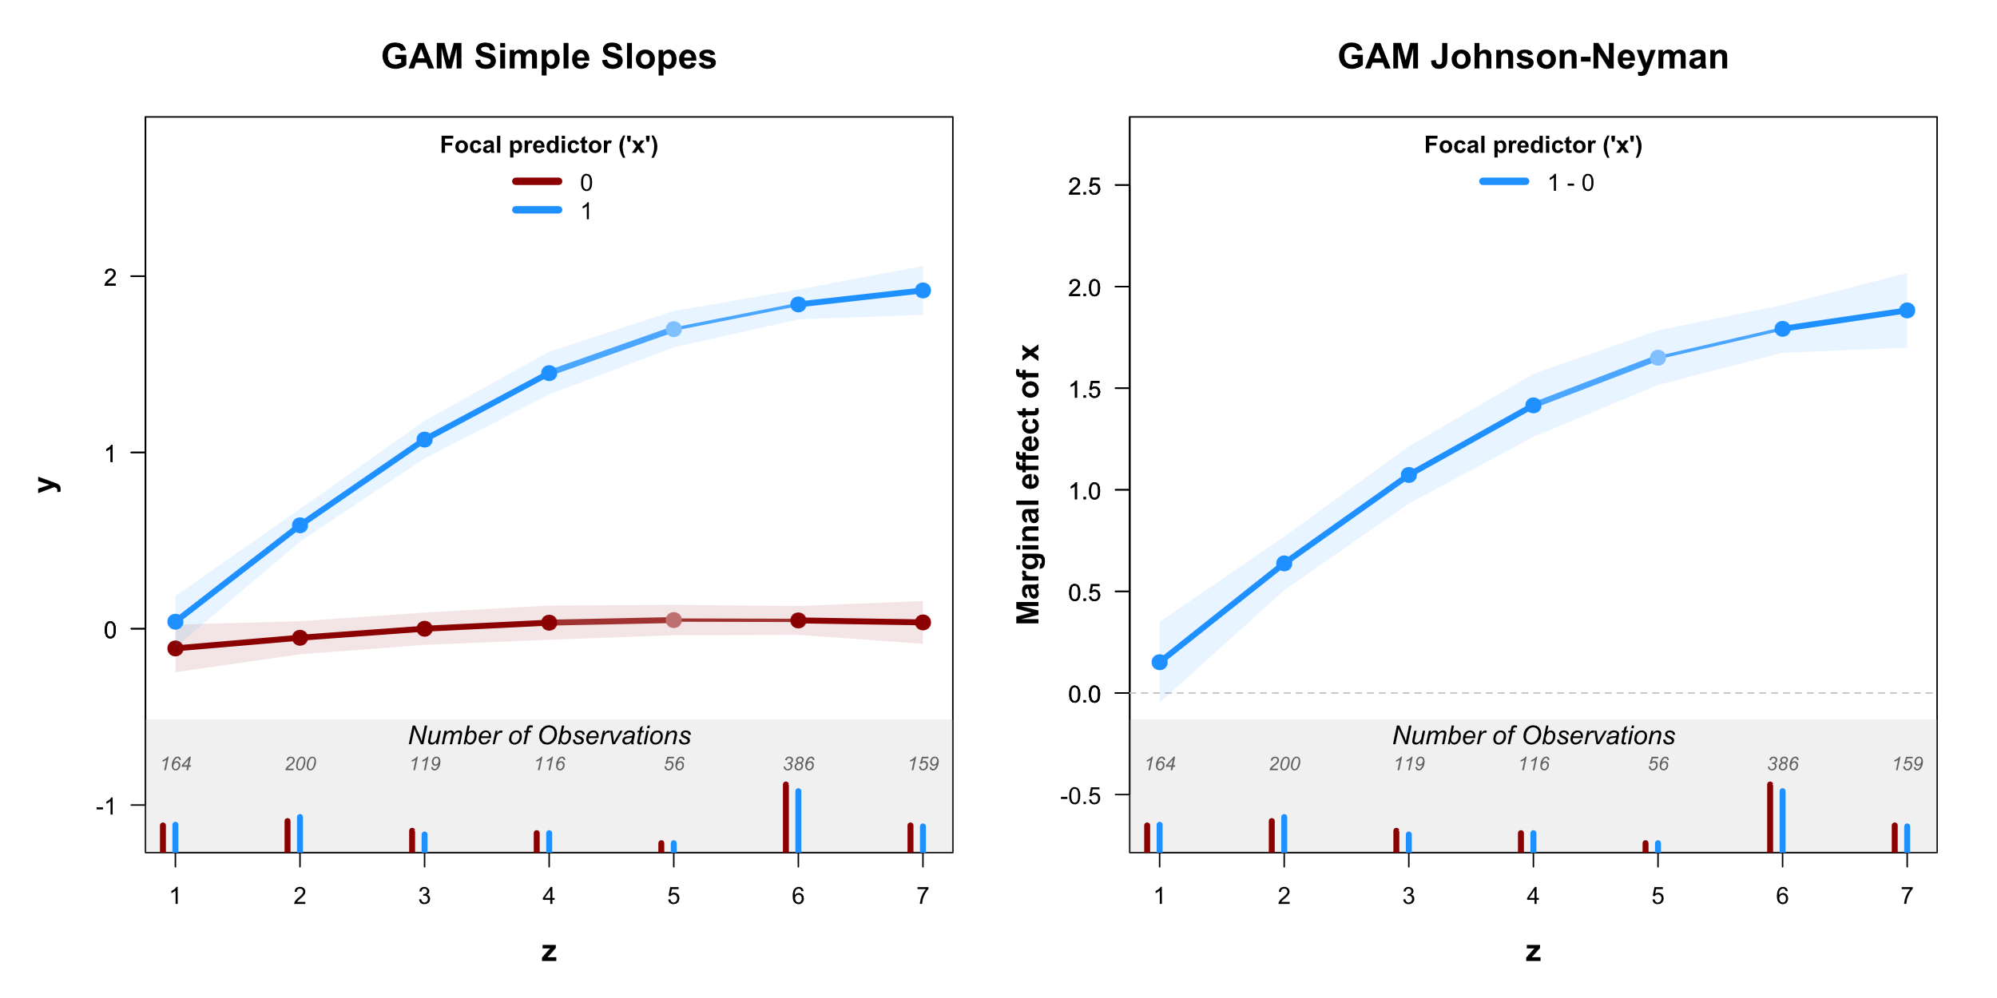
To draw only simple slopes : draw=‘simple slopes’
To draw only Johnson-Neyman: draw=‘jn’/
legend.simple.slopes
main2
main2
ylab2 & ylim2
To have descriptive labels (e.g., ‘control’ vs ‘treatment’) create new variable and use that in interprobe()
Example
condition=ifelse(x==1,
”treatment”,”control”)
interprobe(condition,z,y,…)
legend.jn
ylab1 & ylim1
xlab & xlim

Slide 3
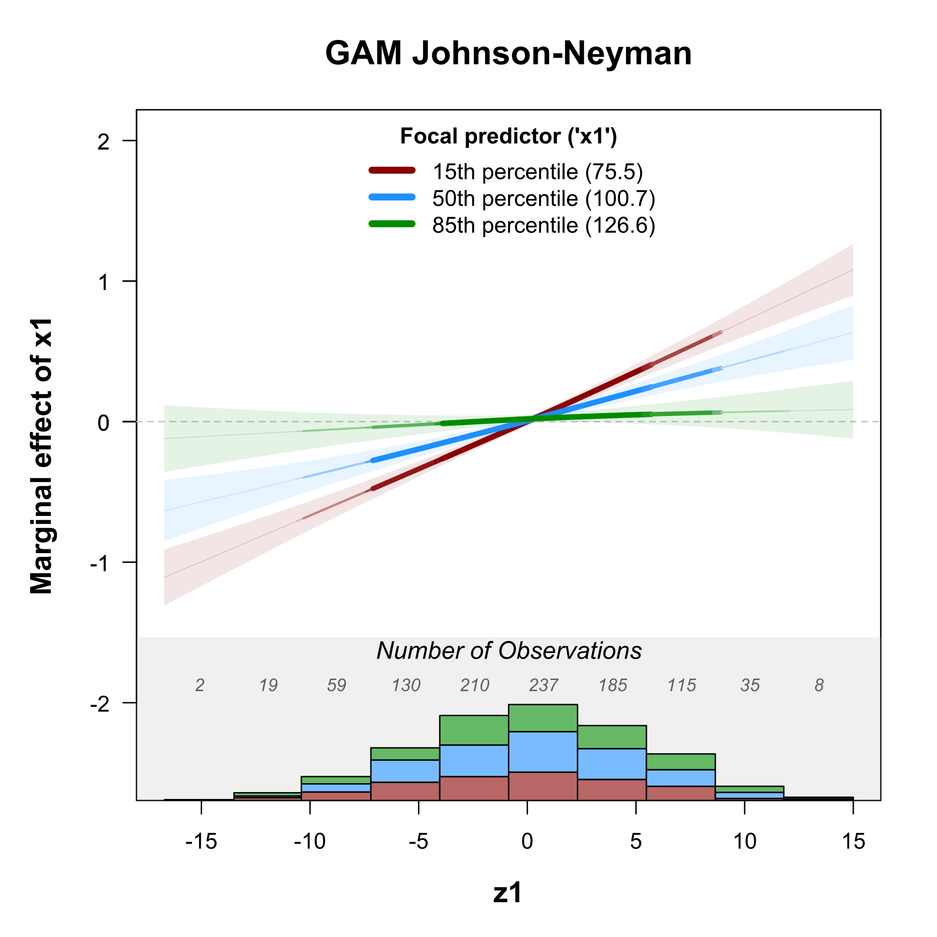
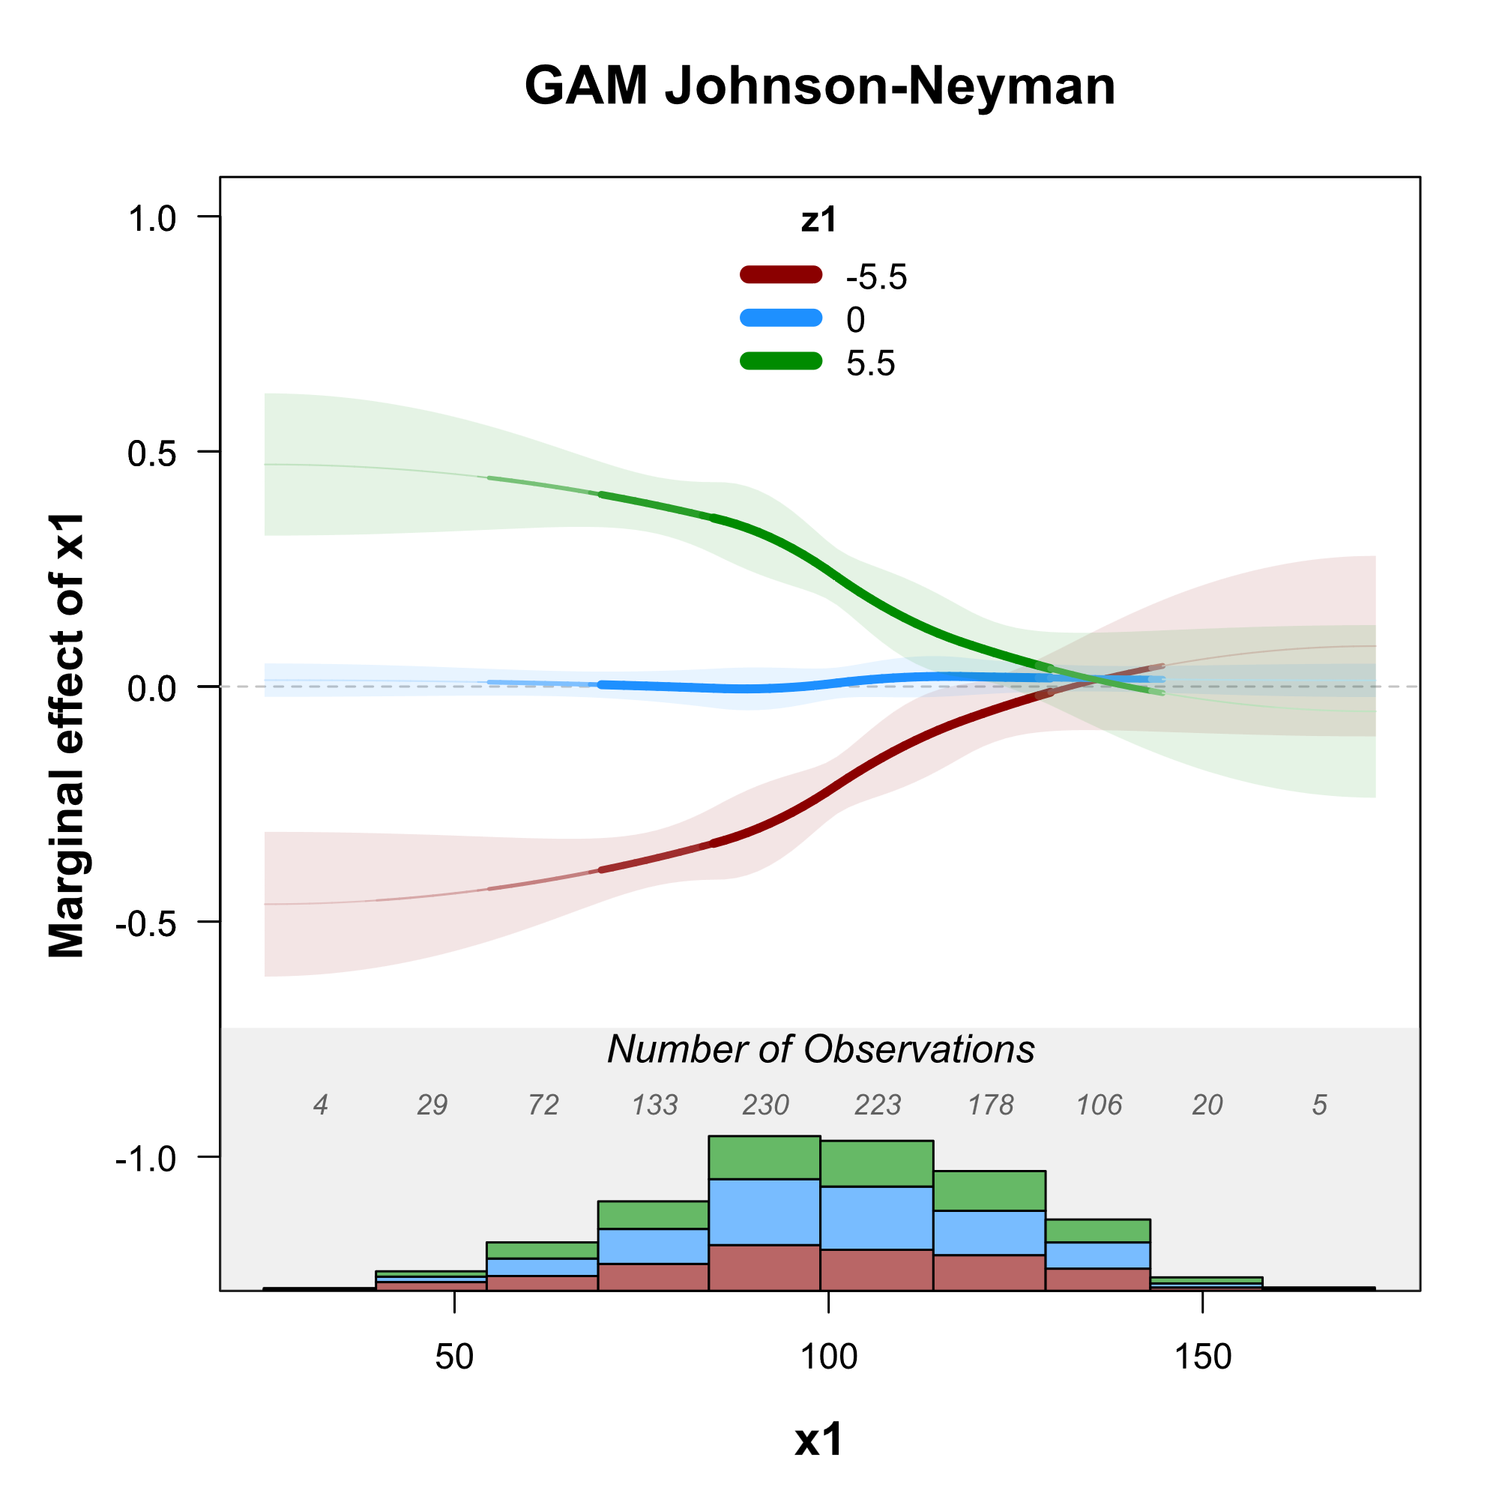
spotlights=c(-5.5 , 0 ,5.5)
moderator.on.x.axis=FALSE

